Slide 1
Making Macroeconomics More Relevant Diana Terzyan & Nathan Lotze
Chapter 8

Slide 2
Introduction
Policy makers missed imbalances
Potency of policies were overestimated
US responded with a more integrated approach than Europe
Policies have been returning to pre-crisis form
Notes:
Policymakers focused on narrow objectives that allowed rampant unregulated financial, macroeconomic, and structural strains to fall under the radar (207).
Initially the US response to the crisis was a mix of rapid monetary easing, fiscal expansion, and effective stress tests on the banks. However, now that the crisis has past, the anticipated recovery never occurred and instead the US economy settled into a state of modest growth (207-208).
Policies started focusing on different goals and because of the modest growth we have all but forgotten to keep the system in check and are even threatening to de regulate under the new administration.

Slide 3
Pre-Crisis
Macroeconomic Policy
Fiscal Policy
Focus on minimizing business cycle fluctuations
Targeted 2 percent inflation to prevent overheating or slack
Long term objectives
Focus on low-sustainable debt and limiting size of government
Doubts about effectiveness of fiscal stimulus
Notes:
Fiscal long term objectives- ensuring the government debt was low and sustainable and limiting the size of government. This definitely is not the case today with a $21 trillion US debt bill and expanding government oversight (209).
Discourage the active use of spending and taxes to dampen the business cycle
The pre-crisis vision of macroeconomics, where central banks were responsible in controlling the business cycle, delivering low and stable inflation and policymakers and other institutions were responsible for maintaining stability and efficiency in the their areas of specialization such fiscal, financial and structural had great influence on the major individuals who played a part before, during and after the crisis. This includes Bernanke and Geithner.
Professor disagrees with the author here, and thinks he is showing his own political bias. It would be more accurate to say that fiscal policy has been driven by ideological beliefs about the appropriate size and scope of government, both on the left and on the right. The last 3 US administrations (Trump, Obama, Bush) have shown no appetite for limiting the size of government. In fact, Bush and Obama expanded the size of government.

Slide 4
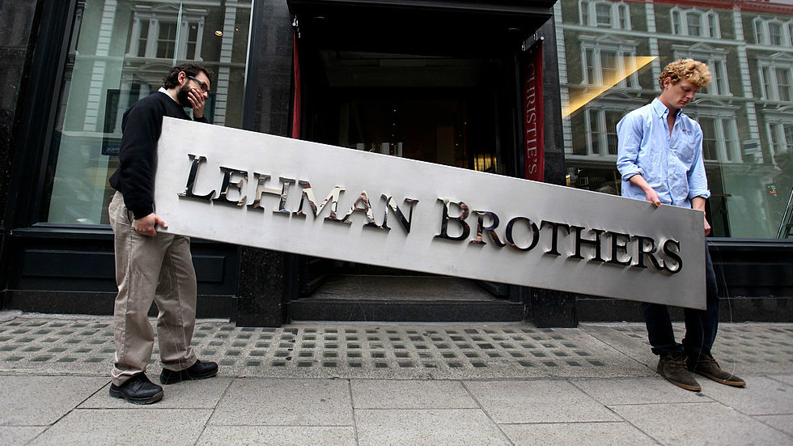
Financial Crisis
Financial sector risk had been discounted by models
Recession drove interest rates to zero
Responses included quantitative easing and fiscal stimulus
G20 Summit coordinated a global fiscal expansion of 2% of output
Macro financial policies have been implemented
Notes:
- Zero interest rates lead to pursuance of unconventional policies
- Head of the IMF, Dominique Strauss-Khan lead the G20 stimulus to try and temporarily boost growth

Slide 5
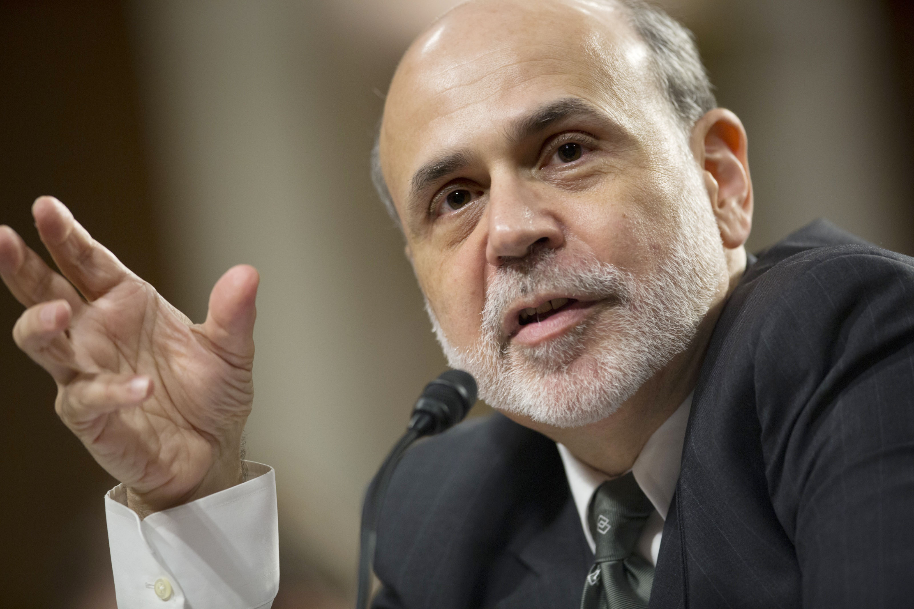
Quantitative Easing
Central banks bought large amounts of assets by printing money
Lower asset supply drove down the interest rates on government bonds
Increased demand for equities, raising their prices
Lowered long term interest rates and exchange rate
Notes:
Quantitative Easing (unconventional monetary policy)- Central Banks buy large amounts of assets (govt bonds) by printing more money. Print more $ to buy assets → decreased number of assets available to private investors→ forcing them to either accept a lower rate on the assets or move their $ to riskier assets (equities or foreign $)
lowered- long-term interest rates→ increased equity prices→ depreciated the exchange rate. (210)

Slide 6
US vs. EU Policy Responses
Fiscal stimulus package
Quantitative Easing
Tough stress tests to encourage increased capital buffers
Banks foreclosed on bad loans
Stronger recovery
ECB remained committed to tight monetary policy
Stability and Growth pack limited fiscal response
National level structural reforms
Banks still hold bad loans
Less strong recovery

Slide 7
Macro Financial Policy
Designed to avoid system risks that may trigger recessions
Examples
Capping mortgage debt relative to value of home
Limit mortgage size relative to income
Generally involves the central bank
Notes:
1) constrains banks from providing high risk loans in which the home owner makes little or no down payment, so that even a small fall in house prices can created defaults and losses for banks
2) curbs banks from providing outsized mortgages which are more likely to be defaulted upon
CB is involved because systemic financial shocks have major macroeconomic consequences and central banks are primarily responsible for macroeconomic stability
Came out of the realization that financial shocks can be systemic and generate major recessions. But was this realization really a new concept or just the ignorance of crises throughout history? (211)
Regulations designed to avoid systemic risks to the financial system. For example, capping the amount of debt that a mortgage borrower can assume compared to the value of a house. (211)
Keeps banks from giving out high risk loans (giving out million dollar mortgages to individuals making minimum wage). (211)
Macroeconomic in 2 senses; (211)
1-Focus on the risk to the financial system as a whole not just individual institutions and link macroprudential policies to central banks as they are primarily responsible for macroeconomic stability.
2-still reflects the pre-crisis notion that financial regulators should take care of financial risks and let the monetary policymakers focus on stabilizing the business cycle. (212)

Slide 8
Policy Compartmentalization
Monetary policy is "too blunt" for financial stability
Used in the 1960s to achieve full employment and external balance
High inflation from government intervention in the 70's
Embraced pro-market approach of Reagan and Thatcher in the 1980's
Still divide responsibility for financial stability and taming the business cycle in separate agencies
Can cause "tunnel vision"
The narrow view caused regulators to miss systemic risks
Notes:
In most countries (US and EU included) reforms remain compartmentalized (i.e. labor reforms being handled by the labor department). This compartmentalization runs the risk of “tunnel vision” and major mistakes because policymakers end up missing warning signs and major threats (213).

Slide 9
More Inclusive View of Macroeconomics Along Three Dimensions
Expanding the Focus on Macroeconomics
Strengthening Domestic Policy Cooperation
A More Inclusive Approach to Macroeconomic Theory
Notes:
To avoid the miscalculations presented by the compartmentalization policy and provide a more robust and inclusive view of macroeconomics is needed along three different dimensions. (213)
1. Expanding the focus of macroeconomics to include potential growth as well as topics surrounding financial stability.
2. Widen the interactions amongst institutions so that macroeconomic decisions can be made in a more cooperative manner.
3. Extend the framework of macroeconomic models beyond the self-seeking individual at the core of most theories (“homo economicus”) to acknowledge the importance of group dynamics and rules of thumb.

Slide 10
Expanding the Focus of Macroeconomics
Objectives | Policies
Stable Inflation | Monetary
High Underlying Growth | Structural
Low Government Debt | Fiscal
Financial Stability | Financial
Notes:
Todays macroeconomic scheme involves four objectives- stable inflation/low slack, high underlying growth (we moderate growth), low government debt (which we do not have), and financial stability (cyclical financial stability?) (214)
It also involves four different policies- fiscal, structural, monetary, and financial. (214)
It is possible to achieve the four objectives using the four policies (instruments) but only if they were allowed to be flexible in helping each other not being compartmentalized the way they are today where one policy is assigned to one objective. (214)
2008 crisis was a product of too much confidence in the self-stabilizing properties of private financial markets and not enough policy (instrument) integration. (215)

Slide 11
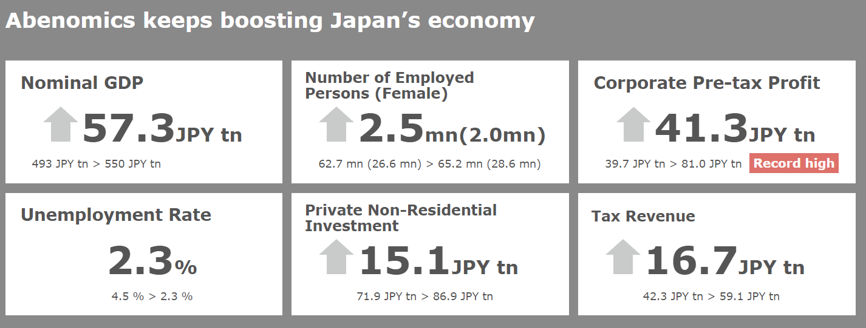
Notes:
“Abenomics” -2012 and again in 2015 in Japan- combined monetary, fiscal, and structural reforms/policies to revive the economy and inflation. Embodies a modern day integrated view of macroeconomic challenges where several policies are used to achieve different objectives. (216)
Abe has combined this integrated approach of using multiple objectives with multiple policies alongside various social objectives and policies to encourage growth in Japan.
Abenomics has not been nearly as successful as the chart claims. Annual growth in Japan’s economy has hovered between 0 and 1 percent, which is not exactly impressive. SO if Abenomics is so great, then why has Japan been stagnating?
Not easy to transfer “Abenomics” to the EU or US. (216)
EU- Too many constraints on policy integrations because the rift that exists between the national interests and the interests of the ECB.
US-There was some policy coordination in the immediate aftermath of the crisis but that has now faded.
Even though a multi policy cooperation is supported on the international level and does have some traction immediately after a crisis, the international cooperation erodes very quickly once the crisis fades into history (217).

Slide 12
Strengthening Domestic Policy Cooperation
Why is it so hard to coordinate policy integration on the domestic level?
What is necessary for domestic policy cooperation?
Notes:
Its hard enough to coordinate policy integration on the international level but why is it so difficult on the domestic level? (218)
Mainly because there is a lingering distrust of policy integration as a result of inflation during the 70s and due to the drive for central bank integration.
Banks don’t deal in the structural and fiscal policy approaches because they worry that governments will then continuously question decision made as a result of monetary policy. This made sense in the 80s and 90s when they oversaw the draining the economy of excess inflation independently of the government.
What is necessary for domestic policy cooperation? (221-222)
Closed meetings (every six months) and frank dialogue amongst the main domestic macroeconomic decision makers (heads of banks, finance ministries, finance regulators, and those responsible for structural reforms/policies.
These meetings would focus on transforming the economic policies to a more integrated method that includes monetary, fiscal, and structural policies and all the members would be forced to focus across all three policies not just those that they are experts in.
The logic around these meetings is that it would put pressure on institutions not to compete with one another and to instead discover a mutually agreeable approach.
Finally the plain and simple fact is that the integrated approach on a domestic level needs to occur because the current policy has either already failed or is failing us in the long-term and if we act on the domestic level, than this can lead to an argument for greater international cooperation.

Slide 13
A More Inclusive Approach to Macroeconomic Theory
Focus on the social+ “irrational economic” expectations
Who is “homo economicus”?
Rational Expectations Approach
Financial Market Bubble= Social Fad+ Rational Expectations Approach
Behavioral Economics
Notes:
This dimension focuses around the backbone of macroeconomic theories which is “homo economicus”. (222)
Which is an individual or “agent” who maximizes “pleasure” or utility given their income and also ensures that the firms they own also MAXIMIZE profits (a point which economists deviated from pre-crisis). Completely selfish “loner” who does not understand the social idea of fairness nor do they care about social acceptance (not a good representative of the everyday individual)
Rational Expectations Approach- Ensures that expectations about the future path of major macroeconomic variables (price, output, interest rates, budget deficits, etc.) corresponds to what the model says will occur. (223)
This focus with the understanding that macroeconomic models require various assumptions to made about the future leads to a more rational approach to macroeconomics, but it is also impossible to predict the future behavior of the market as we have seen.
The combination of the focus and rational expectations can lead to powerful predictions about the macroeconomy but one thing they fail to account for is destabilization factors within the financial market, which no one can predict accurately.
Ex: Investment banker will never predict a “bubble” sort because they know that it can lead to instability and therefore very little profit for them.
This eventually led to the popularity of efficient market hypothesis (where asset prices reflect the wisdom of the crowds and always accurate) amongst policy makers and lulled them into underestimating the risks and financial imbalances pre-crisis. (224)
Professor Robert Shiller of Yale- few prominent economists of time who recognized the massive housing bubble before the crisis. He (along with others) have suggested that financial market bubbles can be modeled as social waves in which ideas catch fire because people ordinary people are keen on impressing one another even it means they make bad choices, and just like any social idea they become self-reinforcing before eventually falling out of popularity or deflating. (225)
Behavioral Economics Approach- Growing in popularity now that we have seen that the normal “homo sapien” tends to be irrational and deviate from pure rationality all together. (226)
This approach examines how people behave in various economic situations rather than how they are supposed to behave.
It has had limited effect on overall economic theory because it is difficult to generalize how individuals will react in more complex situations.
I disagree , I think it is easy to predict exactly how people react during bubbles and crises (especially now that they are cyclical in nature). The issue is that people forget easily.
Economists should not deviate from the maximization theory of homo economicus, they should only do so if there is clear evidence that the contrary is occurring.

Slide 14
Toward a More Encompassing View of Macroeconomics
What is the current paradigm?
Notes:
The low growth and low inflation in the post crisis period, which has technically passed, is still largely in existence and in full throttle mode today.
Financial stability had been the focus of macroeconomic theory instead of the microeconomic theory.
Central Banks remain the instruments to manage growth and inflation while fiscal policy is only looked at in terms of long-term growth.

Slide 15
Big 4 Asset Sizes 1998-2017
 | 1998 | 2004 | 2008 | 2017
BoA | 617.6 | 1,110 | 1,715 | 2,281
Wells Fargo | 202.5 | 427.8 | 1,310 | 1,952
Citi | 256.8 | 1,484 | 1,938 | 1,842
Chase | 740.3 | 1,157 | 2,175 | 2,533
* Figures in Billions of $

Slide 16
Questions
Compartmentalization vs Integrated Approach?
Does fiscal policy work as a form of an effective stimulus?
What is the logic behind having more integrated meetings on top of the meeting we already have among “all stars”?
How easy/difficult is it to predict people’s behavior during periods of bubbles and economic crises?

