Slide 1
Chapter 7
Will Revamped Financial Regulations Work?
Xiaoxiao Feng, Michael Morgan

Slide 2
Introduction
The North Atlantic crisis exposed many flaws and issues with the banking systems worldwide, especially in the US and Europe. As a result, leaders from around the world at the first ever G20 summit agreed to revamp and strengthen the banking system in their respective regions.
This chapter discusses the effects and progress of these reforms in the US and Euro area. The goal of all such reforms is to create a sounder banking system around the world.

Slide 3
At a glance
Initiatives:
Declaration of Strengthening the Financial System
Financial Stability Board
Overhaul of international and national financial regulations and supervision
Strategies:
Tighten bank capital definition
Stricter rules on capital buffers
New liquidity standards
US – Dodd-Frank legislation
EU – Full banking union

Slide 4
Basel Regulations

Slide 5
Upgrading the Basel Rules
The crisis exposed the inadequacy of the Basel 2 International Regulatory rules since many banks that adhered to the rules had to be rescued
Basel 2
Generated inadequate capital buffers due to using historical patterns of shock and correlation
Key Failure: Allowed banks to pick their own risk weights based on their internal risk models
Basel 2.5
Moved the system from these value-at-risk models (VARs) to stressed value-at-risk models (SVARs) which incorporate the lager financial shocks, higher correlations across asset prices, wider margins between the buy and sell prices of assets and higher default risks seen in times of market panic

Slide 6
Upgrading the Basel Rules
Basel 3 (2011)
Aimed to absorb shocks from financial and economic stress
Put a heavy regulatory burden on banks
Increased the size of the capital buffers that banks had to hold against risk weighted assets
European banks pushed for looser rule while US Banks tightened their regulations
Attempt to create a Basel 4 is pushed by US Federal Reserve but is meeting objects from Europeans
Basel reforms only provided a partial solution but provided more stringent rules on capital buffers, including surcharges for systematic banks and new rules on liquidity
The North American financial system is now safer while the Euro area banks remain only subject to internal risk models perpetuating some of the pre-crisis distortions and allowing mega-banks to flourish

Slide 7
Upgrading the Basel Rules
“Basel 4” (December 2017)
Global reform package that will tighten regulations on European Banks
Models for calculating the risk of mortgage assets are more important for European Banks than US counterparts because European Banks hold more mortgages on their balance sheets where as in the US they are offloaded through securitizations
New rules will see an increase in minimum capital for EU Banks
US and EU initially disagreed over the new rules but came to an agreement

Slide 8
Moving Toward a Euro Area Banking Union

Slide 9
Moving Towards a euro Area Banking Union
Agreement to move to a banking union resulted in centralized supervision of Euro area banks at the European Central Bank (ECB)
Split between centralized bank supervision and national responsibility for bank rescues risks undermining the effectiveness of centralized ECB supervision of Euro area banks
ECB supervision solved the problem of banks lacking competition and undermining the results of their stress tests
Unless a Euro area bank rescue fund is created, the gap between the centralized responsibility for supervision and national responsibility for the costs of bank cleanup will continue to create unhelpful tensions between the ECB and national authorities

Slide 10
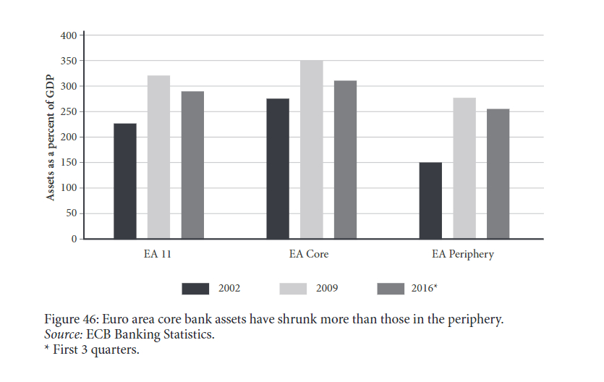
Euro Area core and periphery banks after the crisis
Financial boom of 2002
Banking systems before 2002 were in stable condition
In 2002, SEC made the decision to widen the collateral eligible for repos, creating a financial boom for mostly banks in the US and Europe.
Since 2009, banking system has started to shrink
Banks in 2009 are 300 percent output compared to 2002
Euro area core banks shrank more than Euro area periphery banks
Core banks reduced investment banking
Periphery banks increased government debts

Slide 11
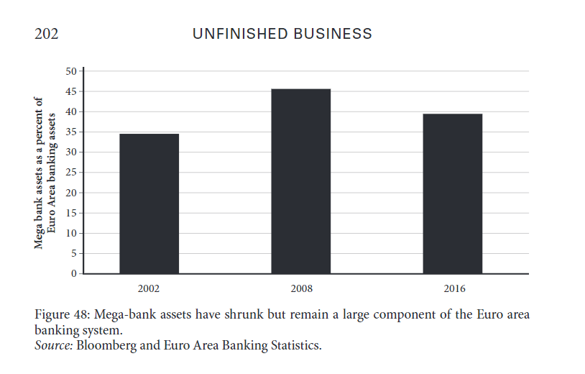
Euro Area Mega-banks
12 mega-banks still larger than what they were in 2002
Most mega-banks received financial support during the crisis except for Dexia
Pullback from investment banking was the most important factor because core banks rely more on investment banking
As an exception, commercially focused mega-banks such as Santander and BBVA were expanded

Slide 12
Refresher from chapter 1 and 4
1996: the banks with the highest Basel ratios were the ones with the highest level of capital
2008: banks with the highest Basel ratios were NOT the banks with the most capital, but the ones who were the most aggressive in manipulating their risk weights

Slide 13
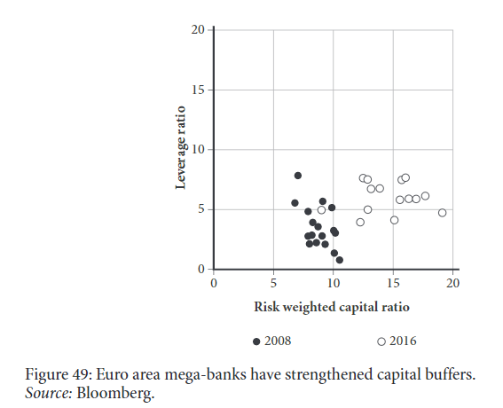
Euro Area bank capital buffers
Bank capital buffers improved compared to 2008
Mostly because of tighter regulations
Higher risk-weighted capital ratios
Less banks with low ratios of equity to assets
A few concerns:
Did not restore the positive relationship seen in1996
As asset prices recover in the future, capital buffers could decrease

Slide 14
Taming the US Shadow Banks

Slide 15
Taming the US Shadow Banks
Three underlying causes
Expansion in securitization of mortgages as higher capital buffers for regulated banks provided incentives for them to sell such as loans to shadow banks with lower capital buffers
Lightly regulated shadow banking system
Widening of repo collateral to mortgage-backed securities and foreign bonds led to an increase in private label securitizations based on questionable mortgages and an increase in dollar borrowing and purchase of such US assets by foreign banks
US regulatory revamp has largely negated the underlying weaknesses
Brought investment banks under Federal Reserve Regulation
Decrease the size of investment banks
Trump Administration seeks to reduce burden for small banks and Volcker Rule

Slide 16
Taming the US Shadow Banks
In Europe, flaws were under a single system where as in the US, there was the dual nature of tightly regulated banks and loosely regulated shadow banks
Most important move since the crisis has been to move the investment banks into the regulated commercial banking sector
Regular banks purchased or absorbed investment banks and others were granted commercial bank operator licenses or remained independent
Investment banks are now safer since they are now regulated
Foreign owned banks were forced to follow US regulations

Slide 17
Dodd-Frank act
2010 Dodd-Frank Act
Ended the silos across regulators that had allowed the rapid pre-crisis expansion of shadow banking system.
Create Financial Stability Oversight Council (FSOC)
Oversees the entire US Financial system for systemic risks
Collins Amendment: Limits the ability of large US banks that adhere to the Basel Rules to use internal risk models to manipulate risk weights (no longer us internal models only but a standard system)
Large US Banks are subject to three regulatory capital approaches:
Opaque internal risk model calculations of risk-weighted assets
Simpler and more verifiable standardized approached to risk weighted assets
Basel 3 leverage ratio on total assets
Volcker Rule: disallows banks from most trading in markets on their own behalf and raised the capital buffers on the reminder
Nationalization and reform of Fannie Mae and Freddie Mac

Slide 18
Taming the US Shadow Banks
Federal Reserve announces regulation rollback (October 2018)
Looser capital and liquidity requirements for large US lenders
Largest US Banks (ex: JPMorgan) would not see significant rule changes
Some argued it would weaken the financial system others thought regulations are burdening the financial system
Propose offered banks more flexibility in how gains and losses in securities portfolios affect their capital level which could reduce the amount of capital and liquid assets they must maintain

Slide 19
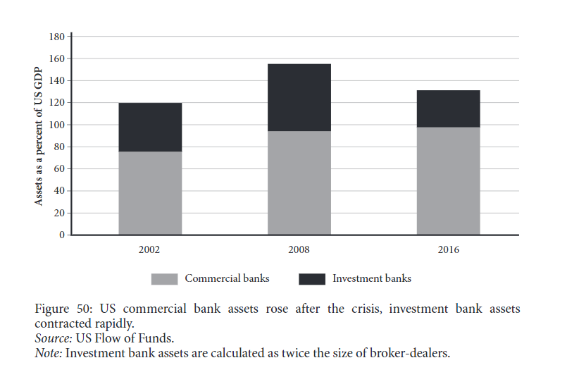
US Post-crisis banking system
US passed Dodd-Frank legislation
Regulated banks expanded
Investment banks shrank by almost a half
Overall banking system is less than 2008, similar to 2002

Slide 20
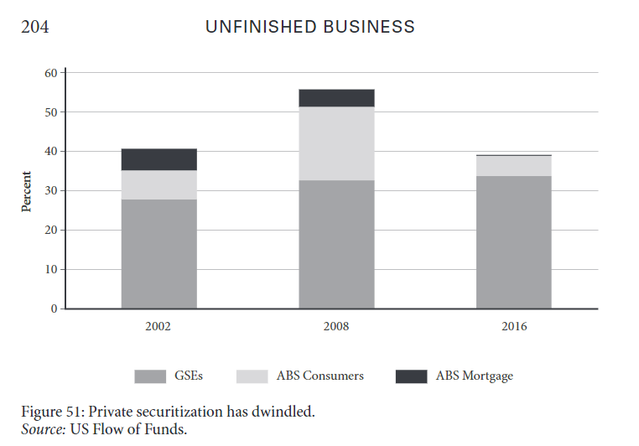
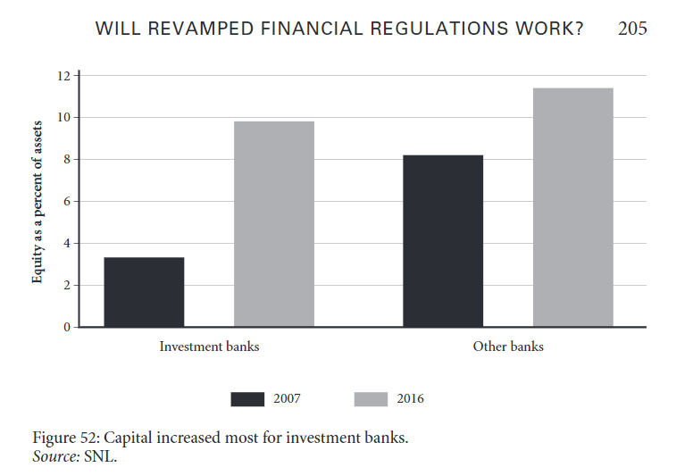
US investment bank capital buffers
Larger roles for GSEs - Government Sponsored Enterprises
Fannie Mae and Freddie Mac guarantee 60% of all US mortgages
Independent investment bank capital buffers increased dramatically from 3% in 2007 to over 8% in 2016
Meanwhile regulated banks and other banks only increased slightly

Slide 21
CONCLUSION
In Euro area, the European Central Bank is the supervising entity that oversees the major banks. This effectively removed unhealthy regulatory competition
Unfinished business:
Need to finish the planned regulatory revamp and continue to eliminate overbanking
Need to supervise mega-banks so that they do not manipulate the risk weights
Need to solve the issue of banking support. Banking system costs are still national
In the US, investment banks are now under federal supervision with tighter regulations and improved capital buffers.
Unfinished business:
US revamp is basically complete. US just needs to ensure that there will not be Glass-Steagall separation between commercial and investment banking

Slide 22
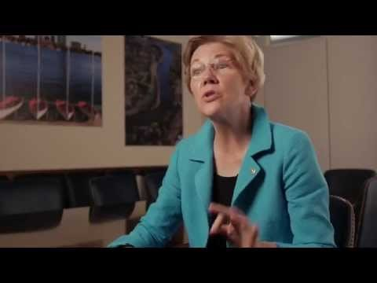
Video: “The Story of Dodd-Frank at 5 with Elizabeth Warren and Americans for Financial Reform”
https://www.youtube.com/watch?v=3foBrqHVCOo

Slide 23
Question and Discussion
Do you think the Dobb-Frank Act is going overboard?
Do you agree or disagree with Senator Elizabeth Warren’s view?
Should the government reintroduce a Glass-Steagall separation between commercial and investment banking?

