Slide 1
Boom and Bust
Liam Hennelly, Christine McClung, Giselle Rodríguez, Gula Tang

Slide 2
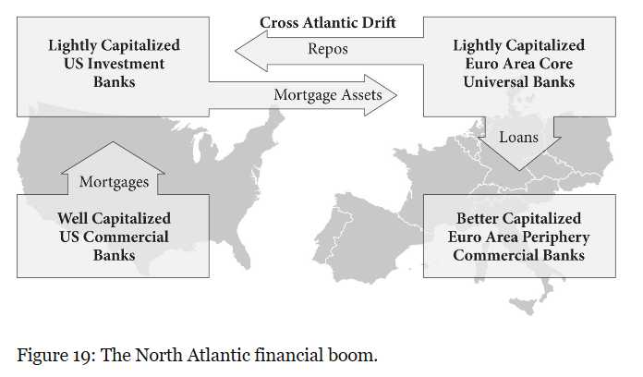
From 1980 through 2002 the North Atlantic financial system was gradually getting worse.
US -> Boom in shadow banking and house price inflation
Euro Area -> Boom in lending by their banks due to inadequate regulation and supervision

Slide 3
Regulators and the Cross-Atlantic Financial Drift
1980s and 1990s regulations aimed to integrate the European financial system and integrating the US banking system.
In 2000, the introduction of the Euro
The integration of the US banking system
Balance of rules on capital charges across international banks
Runup to the crisis between 2002-2006
Euro banks financed the US housing bubble
They bought a large amount of securitized US mortgage loans

Slide 4
How US Repo Markets Funded the Housing Bubble
Three regulatory lifts to the repo market:
April 2003 -> Release 47683 of the SEC, which added foreign paper and securities related with the US housing market. In general, it expanded the collateral that US broker-dealers could use in repurchase agreements with clients.
April 2005 -> The Bankruptcy Abuse and Consumer Protection Act was passed
This act extended “safe haven” protection to most of the expanded repo collateral granted by the SEC. By extending safe haven status, it would limit the systemic risks of repo transactions.
NOTE: What do they mean by “Safe Haven”?
What was its effect?
Irony: The collapse of Lehman Brothers created the opposite of what the safe haven was supposed to avoid
July 2005 -> Basel Committee decreased capital requirements for repos

Slide 5
Consequences & Drivers
Failure of US consumer protection for subprime mortgage borrowers (Driver)
Changes in repo regulations (driver)
Increased participation of foreign banks in the US repo market (consequence)
Increased desirability of high-yielding mortgage-backed securities issued by private firms (consequence)

Slide 6
How the Basel Committee Encouraged Euro Area Mega-Banks
Refresher: Basel Committee on Banking Supervision (BCBS) is a committee of central bank governors, primarily European and American.
Basel 1 was a series of meetings/deliberations that revolved around credit risk and capital requirements. This happened during the period of 1988-1992.
Basel 1 system have broad risks buckets but those were not very refined, risk weights were not fully taken into consideration, the main point debated about was who would assign risk weights, the banks or regulators.
Basel 2 period, can be considered from the late 1990’s when discussions/ideas began to be pushed about reforms that need to be made to Basel 1 regulations. From 2002-2004 these rules were considered and adopted but it wasn’t until 2007 that implementation formally began.

Slide 7
The Long and Winding Road to Basel 2
Both U.S. Federal Reserve officials and those within the financial industry called for changes to the Basel 1 rules begin in the later 1990s.
A big sticking point was capital buffers and models for credit risk.
Banks were lobbying for using internal models instead of credit ratings to assign risk weights. Basel 2 agreed to let commercial banks use internal models to calculate credit risk, banks wanted capital requirements to decrease. Investment banks had already been allowed to use internal risk models for weights.
Commercial banks in the United States were not allowed to use internal risk weights models. Banks in the United States were subject to different leverage ratios.
William McDonough: President of New York Federal Reserve (he was later succeed by Tim Geithner). A lead member from the U.S., chairing the committee when it began drafting Basel 2 rules.
The McDonough Ratio: an evolved version of the a rule from Basel 1. This rule involves the calculation that banks use to risk weighted assets. Basel 1 did not weigh rates based on borrowers of differing quality. The McDonough allowed to varying weights to be assigned to the quality of borrows.

Slide 8
Three Pillar of Basel 2
Pillar 1: Minimum Capital Requirements
-Revolved around credit risk and the amount of capital banks needs to have on hand.
Pillar 2: Supervisory Review
-Revolved around the responsibilities and roles of regulators in monitoring/enforcement of the rules from pillar 1.
Pillar 3: Market Discipline
-Revolved around disclosures and compliance.

Slide 9
Internal Risk models as the Golden Goose
The committee allowed for banks to continue using internal models to cover credit risk but that was in many situations not fully considering the effects on banks capital requirements.
Wide variations in the estimated capital buffer needs meant banks, particularly European Banks, were able to manipulate these models. This meant regulators often had inaccurate information and made it harder for them to assess these models and the impact they posed for the amount of capital buffer banks needed to have on hand.
Large mega banks were using the flexibility these kinds of internal models allowed to lower their capital buffers. (Lower capital meant higher chances of bank insolvency issues)
Large European banks were lending to American banks.
The Basel 2 regulations were vague and in some ways not designed to be effectively enforced.
Although these rules were not being implemented until 2007, many banks moved toward those standards beforehand, laying the groundwork leading up to the 08 crisis.
Notes:
Liam- Professor is going to step in to discuss the weighted risk models.

Slide 10
Before we get to the charts! Quick Review:
•European bank assets expanded massively over the 2000s because of thinning capital buffers
• They provided much of the funding for the US housing bubble
•They were using internal risk models to save on capital buffers
“In 2007, right around the time of the US subprime problems, the northern European banks (Euro area plus UK) owned US assets worth over one-quarter of US output, three times the ratio of 2000”
“Between 2002 and 2007 the increase in US assets owned by northern European banks was almost exactly equal to the increase in US private label mortgage securitizations.”

Slide 11
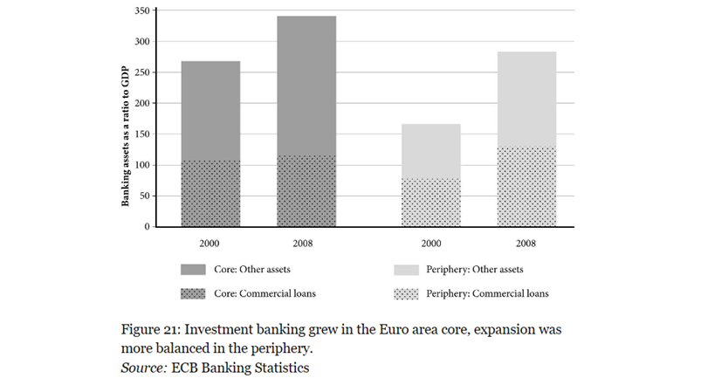
Charting the Unsustainable North Atlantic Financial Boom
The Unwise Overseas Expansion of Core Euro Area Banks
Takeaways?
Core: Very little of the growth/expansion came from commercial loans
Periphery: Expansion of assets more balanced
i.e. rapid growth of investment banking in Euro Area.
Why is it important?
“Other assets” are mainly securitized assets from investment banks which are riskier, less regulated and less capitalized so it shows the riskier part of the system was growing fast!

Slide 12
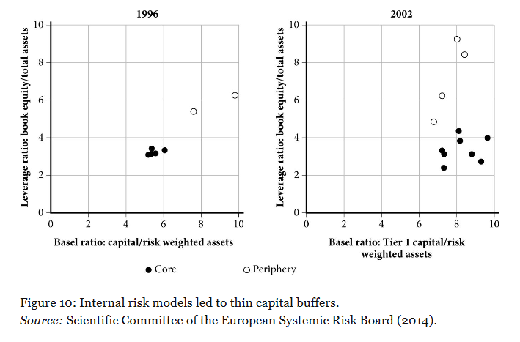
Refresher from Chapter 1:
Last week we looked at figure 10 which only showed us the movement of plots from 1996-2002

Slide 13
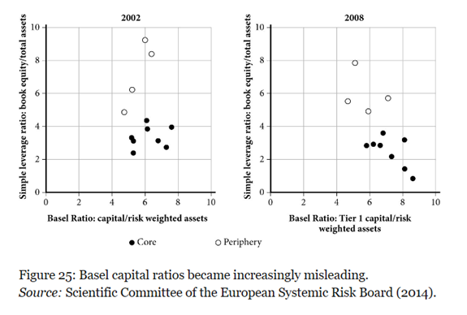
Charting the Unsustainable North Atlantic Financial Boom
The Unwise Overseas Expansion of Core Euro Area Banks
Takeaways:
We can see a major shift from 2002 to 2008 as the plots move to a more negative correlation.
Why is it important?
By 2008 banks were using the basel ratio to “play” with the riskiness of their assets. Banks were taking riskier investments than their basel ratio showed but their levels of capital were not adjusting properly.
Notes:
This is a continuation from chart in chapter 1. Leverage ratio= capital/assets, Basel Ratio= capital/risk weighted assets, you are going to take your assets and add a risk ratio to them, give certain assets a risk weight, like the government bonds are safe so they get 0%, mortgages, 50%. Who is choosing the risk rates? Oringally it was the regulator but then banks were choosing it. Leverage ratio has to be used to check the basel ratio to ensure they aren’t playing with the numbers.

Slide 14
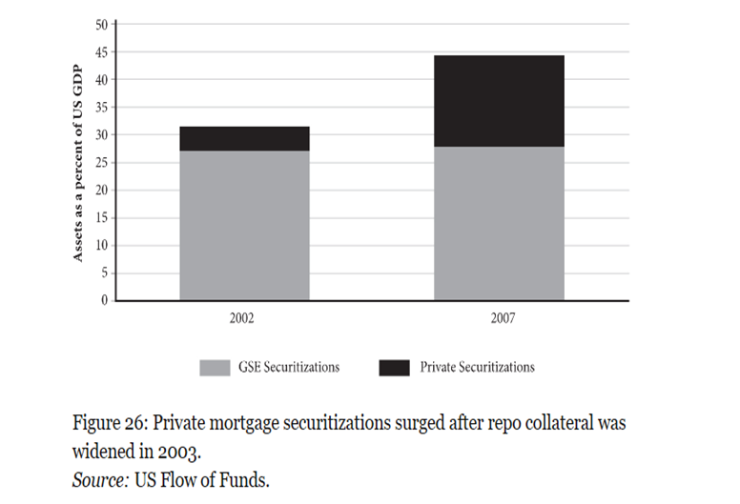
Charting the Unsustainable North Atlantic Financial Boom
The Changing Face of Securitization
Takeaways:
2002 securitizations were small players in the investment markets
2007 they comprised a quarter of a larger market
GSEs really didn’t grow. Growth came from the sub-primes.
Why is it important?
This type of rapid growth included a larger role for shadow banking which absorbed securitized assets. More risky, less regulated assets!
Notes:
This connects a lot of 1 and 2. This is a coninuation as to figure 13. GSEs did not grow (fannie and freddie) all the growth came from sub-prime.

Slide 15
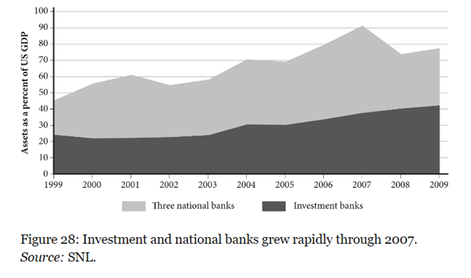
Charting the Unsustainable North Atlantic Financial Boom
The Changing Face of Securitization
Takeaways:
At the peak in 2007 the assets of the three national banks + investment banks were almost as large as US output.
Why is this important?
Remember the “too big to fail” or “too big to regulate” idea? If 3 national banks + investment banks can make up almost 90% of US GDP, how can we allow them to fail?
*Investment Banks= Morgan Stanley, Goldman Sachs, Merrill Lynch, Lehman Brothers, and Bear Sterns
*3 regulated nations banks= Citi, JP Morgan Chase, Bank of America.
Notes:
From 1999 they doubled in size. But also too big to save because it would be so costly

Slide 16
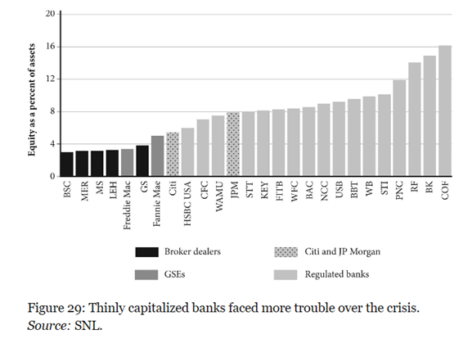
Charting the Unsustainable North Atlantic Financial Boom
The Changing Face of Securitization
Takeaways:
Across the 26 largest US-owned financial institutions, 3 of 4 lowest capital ratios were associated with investment banks that subsequently failed or had to be rescued (Bear Sterns, Merill Lynch and Lehman Brothers)
Why is this important?
Proves the authors point, the thinner the capital buffers the more likely it was that a bank would fail.

Slide 17
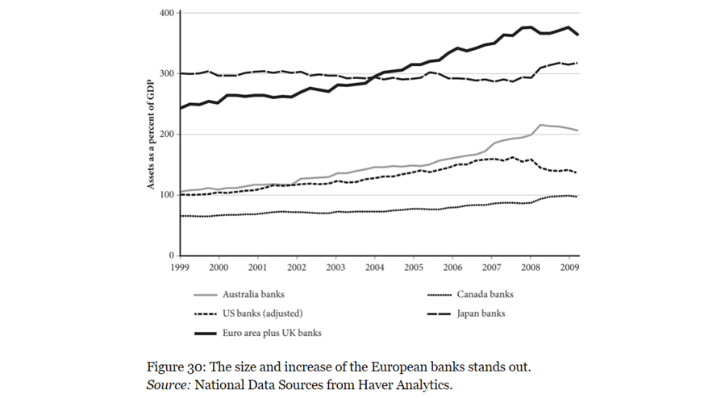
Charting the Unsustainable North Atlantic Financial Boom
Was the Behavior of the US and the European Banking Systems Typical?
Takeaways:
Canada and Japan were dominated by commercial banks, this shows them remaining relatively stable.
Australian banking system, had a universal bank model and did expand over the boom of the 2000s and suffered a wholesale funding run over.
Why is this important?
Leads us into the author’s conclusion that the major drivers of the expansion of the Euro banks were the universal banking model and overexpansion from lax oversight due to regulatory competition. Main driver was not Basel 2.

Slide 18
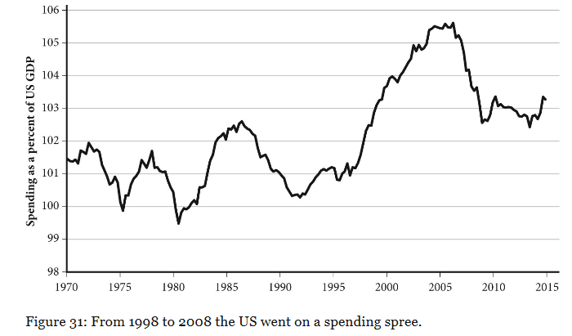
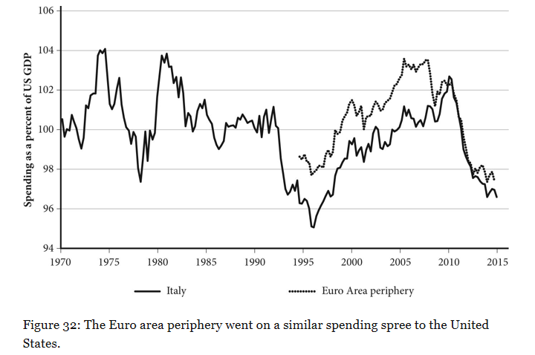
Charting the North Atlantic Boom and Bust
The Similar Cycles of Aggregate Spending on the Both Sides of Atlantic

Slide 19
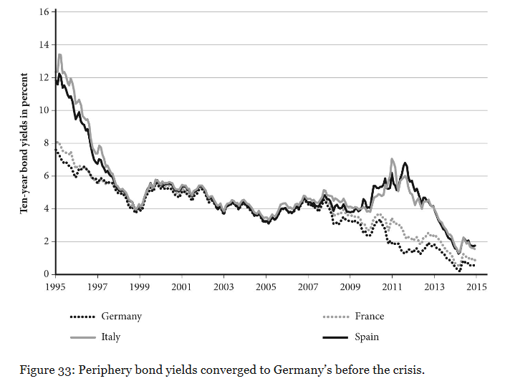
Charting the North Atlantic Boom and Bust
Lower Funding Cost Led to Booms in Investment
The Euro area financial boom occured in the Periphery while the much of the lending capacity were concentrated in the the Core.
The spending boom in the Periphery was sparked by the rapid fall in long-term interest rates, as entering EMU reduced risk premiums.

Slide 20
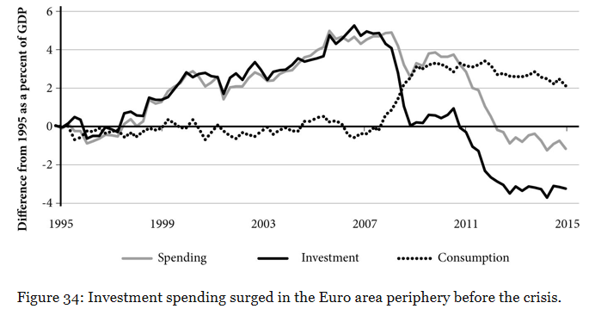
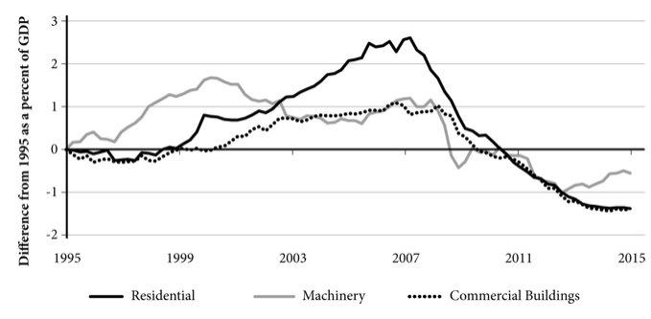
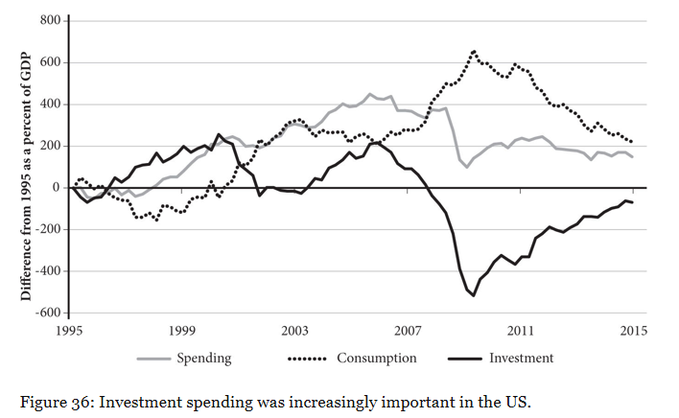
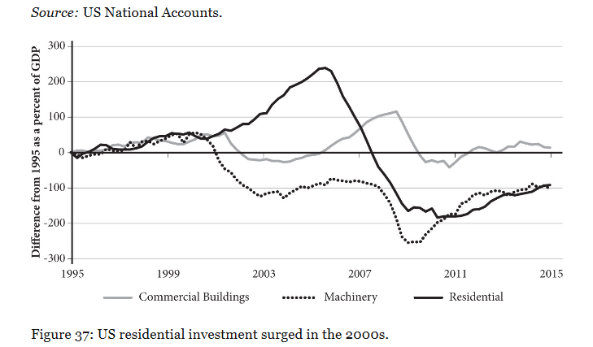
Charting the North Atlantic Boom and Bust
Investment Flows into Housing
-EU-
-US-

Slide 21
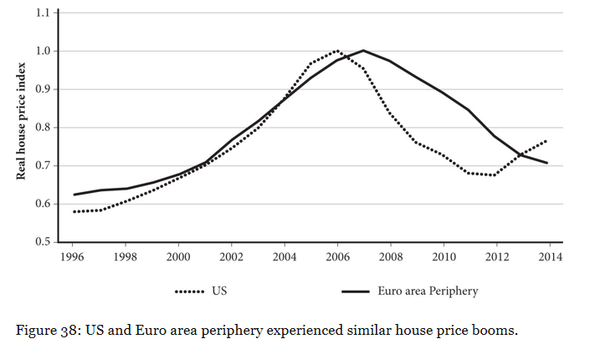
Charting the North Atlantic Boom and Bust
Similar Booming Housing Prices on the Both Side of Atlantic

Slide 22
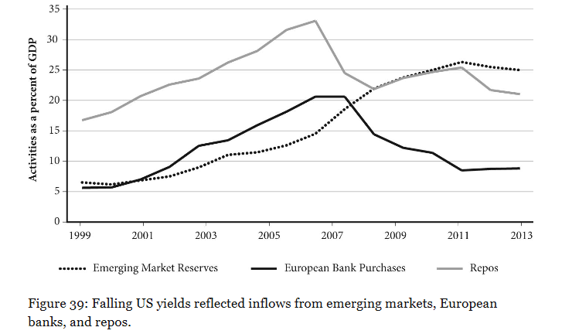
Charting the North Atlantic Boom and Bust
What Lowered US Bond Yields in 2000s?
All 3 hypothetical drivers are mattered:
Inflows from the Emerging Markets;
Inflows from the EU lower rates;
The rise in repos;
The rise of counterpart to these assets are important as Fed focused on inflation rather than domestic demand.

Slide 23
Conclusion
Similar Macroeconomic Booms, Dissimilar Busts
Crises on the both side of Atlantic were driven by the same underlying dynamics.
The reason for the different timing lies in the lending used to finance the bubbles: The price of US mortgaged-backed securities was more responsive to the subprime problems, while the bad loans were retained on the bank balance sheets in the Euro area.
The more destructive impact in Euro area reflects EU’s deeper structural weaknesses.
Individual decisions taken during the crisis are also important to the dramatic process of the crises.

Slide 24
Questions and Discussion Points
What do you consider the major takeaways are from this chapter?
Do you think the conditions that led to boom and bust were reasonable at the time they were created?
What improvements can be made in the future, in terms of risk management policies and models?
What critiques do you have for the Basel committee?
What do you think should have been given more attention?
Anything else?

